Slide 1



WIDS Datathon 21 3rd place
ScientificMind
Notes:
We, the ‘ScientificMinds’ Team from Israel, are very honored and proud to be here.
We worked very hard on our solution, and got lucky to get a winning place!
We are now very positive about sharing our solution to make an impact!
We would like to thank you all very much for granting us this grand oppotunity.

Slide 2
Agenda

Slide 3
Agenda
Background
Summary
Feature selection & engineering
Training methods
Important findings
Simple model
Notes:
Our agenda for today:
Our background – each team member will present himself / herself
Summary – Summary of our solution in terms of Process, Models, Time-Frames
Feature Engineering & Selection
Training Methods used
Important and Interesting Findings
The Simple Model

Slide 4
Background

Slide 5
Background
Pavel Vodolazov
B.A. Economics, M.Sc. Financial Mathematics
5 years as Quantitative Analyst
5 years as Data Scientist (finance, telecom, anti-terrorism)
Currently Data Scientist / Innovation Coach @ NEC Corporation
Maya Saghiv (Tadmor)
B.Sc. Industrial Engineering, MBA, PMP
Certified Data Scientist (Technion)
10 years of experience: Operations, Business Optimization, Analytics
Next step: 1st role as ‘Data Scientist’!

Slide 6
Background
Or Katz
B.A.Sc. Electrical and Electronics Engineering, MBA
Kaggle Competitions Master
Kaggle Notebook Master
Deep Learning Researcher / Innovation Coach @ NEC Corporation
Liz Cohen
B.Sc. Biomedical/Medical Engineering, M.Sc. Electrical and Electronics Engineering
Deep Learning Researcher / Innovation Coach @ NEC Corporation

Slide 7
Summary
We heavily used GBDTs, TabNet, classic methods like Logistic Regression, RF, Kmeans.
It takes ~24 hours to fully train the system on an average machine. HPO took a way much longer.
Notes:
This slide presents the Solution Summary - models we used, the process & Time Frames in ‘high level’
Process:
Our Model was an ‘Ensemble’ running on 120 ‘Single Models’
Training
Single Models:
3 types of GBDT: LightGBM, Catboost, XGBoost (chose these algorithms due to good prior experience, were more confident as they also produced good results in this challenge)
Classic Methods: Logistic Regression, Random Forest
Tabnet
Performed 5-fold CV for each model
Ensemble Algorithm - Logistic Regression (will be elaborated later)
Kmeans Algorithm – used for Cluster–Based Data Imputations (will be elaborated later)
HPO & Training Time Frames:
HPO with Optuna – overall a few days
Training – 24 hrs

Slide 8
Features Selection/
Engineering

Slide 9
Features Selection/Engineering
Best features are :
Many different insights from glucose
Diastolic BP, hemoglobin, BUN, creatinine, MBP,
Age, weight, BMI, ethnicity (probably indirectly), GCS Unable APACHE
Notes:
‘Best Features’ (variables with highest Information Gain) according to best Single Model, Catboost w/o Data Imputation (will be shown in next slide)
‘Best Features’ can be divided into 5 categories:
Insights from Glucose – given / created by us (elaborated in next slide)
Vitals – e.g. Dialostic BP (Dialostic Blood Pressure), MBP (Mean Blood Pressure)
Labs – e.g. Hemoglobin, BUN (Blood Urea Nitrogen Concentration), Creatinine
Demographics – Age, Weight, BMI, Ethnicity (genetics & environment)
Apache – e.g. GCS Unable apache (GCS (Glasgow Coma Scale) is a scale for ‘Apache’ measuring – Eye, Motor, Verbal)
BUN & Creatinine – measure Kidney functions (poor function indicates severity, means the patient has been diabetic for a while)
GCS_Unable_Apache –
Apache measures the severity of illness according to Glasgow Coma Scale (GCS)
Every patient in ICU receives an ‘Apache’ score
‘gcs_unable_apache’ - Whether the Glasgow Coma Scale was unable to be assessed due to patient sedation (הרגעה)

Slide 10
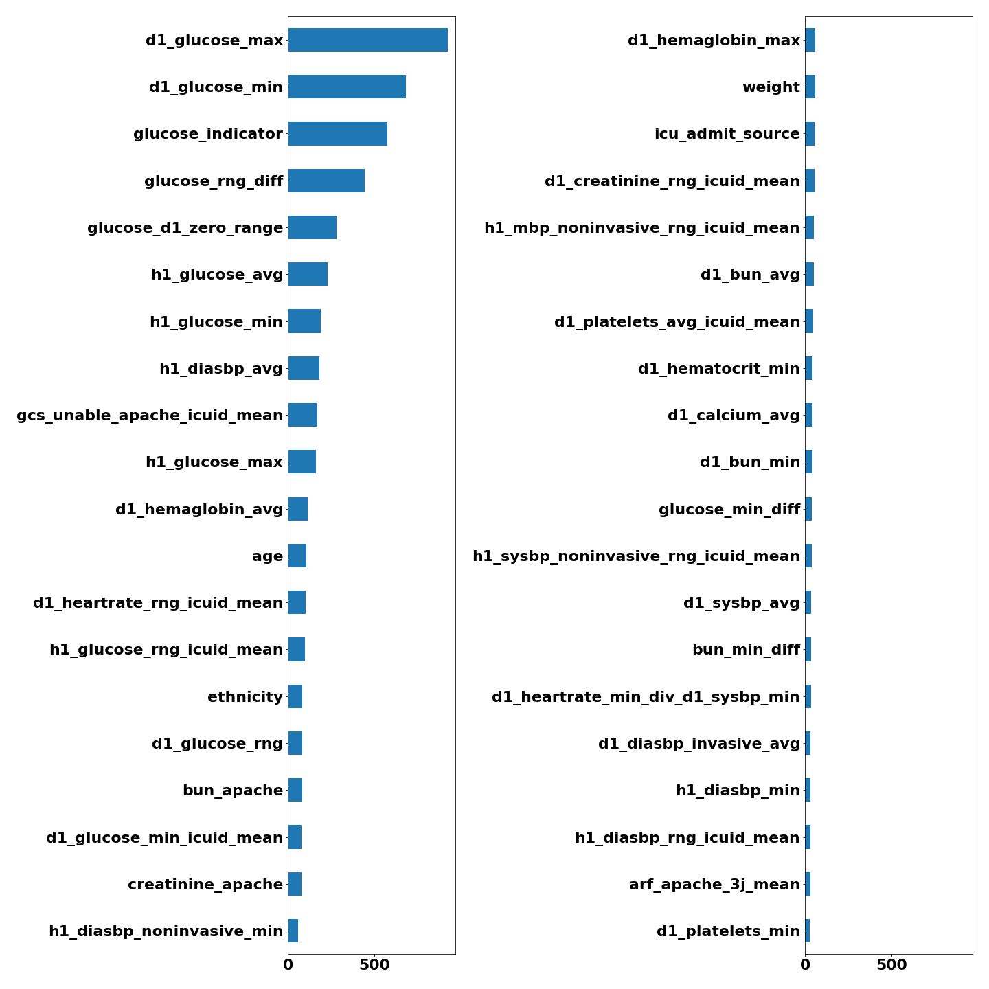
Features Selection/Engineering
Features Selection/Engineering
Variable Importance Plot
Variable Importance Plot
Notes:
These are the ‘Best Features’ (variables with highest Information Gain) according to best Single Model, Catboost, on Selected Features after Bias Mitigation, w/o Data Imputation
All top 5 important variables are directly related to the Medical & Physiological logic behind the Dataset
‘d1_glucose_max’ reflect the severity of the patient
Remaining 4 features reflect the ‘dynamics’ between the preliminary metabolic state of the patient & the metabolic state after 24 hours, taking into consideration:
Diagnosis
Treatment
Patient’s response
Focus on Important ‘Insight’ Feature proudly created by the Team:
glucose_rng_diff = d1_rng-h1_rng
d1_rng=d1_max-d1_min (changes in 1st day) / h1_rng=h1_max-h1_min (changes in 1st hour)
This data may be an indicator of ‘hidden’ information regarding patient’s changing level of glucose during the 1st 24 hours, reflecting patient’s DYNAMICS
Other important ‘Insights’ to draw the attention to:
glucose_indicator – formed by the community, checks if any given glucose measures equal each other (e.g. d1_glucose_min=h1_glucose_max)
glucose_d1_zero_range – checks if glucose values were changed during the day (glucose_d1_min=glucose_d1_max)
h1_glucose_avg – average between ‘h1_glucose_max’ and ‘h1_glucose_min’

Slide 11
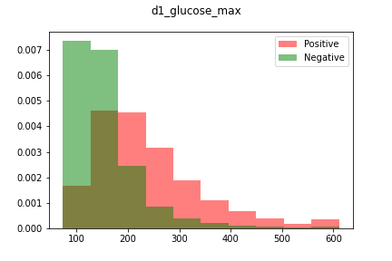
Features Selection/Engineering
Partial Plot of d1_glucose_max
Notes:
Now we will take a look into density plots of some of the important variables
X axis – Feature Values
Y axis = Density
‘100’ is a borderline value for diabetes mellitus, though there are some ‘Positives’ below
The highter the ‘d1_glucose_max’ meaure is => the higher the probability is for a ‘Positive’

Slide 12
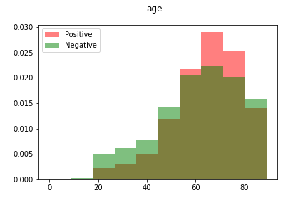
Features Selection/Engineering
Partial Plot of Age
Notes:
X axis – Feature Values
Y axis = Density
Highest density between 50Y-80Y
Above 80Y density is low probably due to higher mortality rate of Diabetic Patients

Slide 13
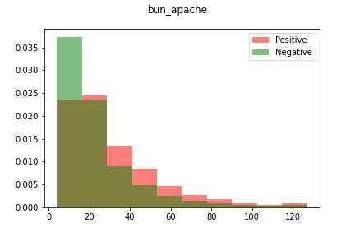
Features Selection/Engineering
Partial Plot of bun_apache
Notes:
‘bun_apache’ – the component of ‘bun’ (blood urea nitrogen concentration – Kidney function) in Apache (severity of illness)
X axis – Feature Values
Y axis = Density
Higher bun_apache is correlative to a higher probability for ‘Positive’

Slide 14
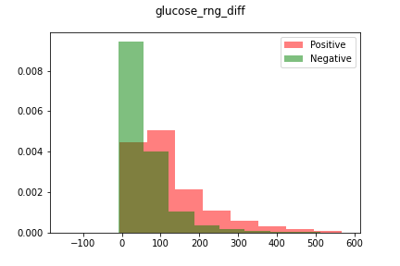
Features Selection/Engineering
Partial Plot of glucose_rng_diff
Notes:
This is the Specific Feature we created, which we are very proud of!
It represents the Dynamics in the patient’s Metabolic State in the 1st 24 hours, considering patient’s diagnosis, treatment & response
In this density plot, we can see how highly informative it is
X axis – Feature Values
Y axis = Density
The greater ‘glucose_rng_diff’ is => the higher the probability is for ‘Positive’ (may be an indication of treatment)
We are very proud of this highly indicative feature!

Slide 15
Training Methods

Slide 16
Training Methods
We believe in NFL theorem: we create a big amount of solid and as much as possible diverse models to be able fetching all the insights out of the datasets and then ensemble them into a single model.
We first create a big number of models (~180) and then run logistic regression with L1 penalty. We drop all zero-importance models and rerun the ensemble couple of time, until there is no zero-importance models. In the end of the process 120 models remains.
Kaggle Winner Presentation Template
Notes:
The Metabolic state of a patient is a very complex situation. To understand complex situations, you need to use diverse models and different algorithms, and then synergize between them
NFL (No Free Lunch) = There is no universally best algorithm for all problems
Each model produces its own insights
Models should be as diverse as possible to produce different insights
The ‘Ensemble’ aggregates all insights from all algorithms
Logistic Regression with L1 Penalty (“Lasso Regression”)
Identifies well the ‘Zero Importance’ models
Every rerun improves the final CV score, and identifies new models with ‘Zero Importance’
Convergence was at 120 models of 180 at the beginning
‘Negative’ contribution to the Final CV score:
Some models deteriorated the Final CV score
We assumed this indicates those models contribute important information
We decided not to remove them from the solution

Slide 17
Important and Interesting Findings

Slide 18
Important and Interesting Findings
What we probably did more then other participants:
Recycled features from the last year competition
Monitored all public notebooks for a new ideas.
Bias mitigation (nothing works without it)
Believe in our CV and not trying to overfit on public test set.
We took the competition very seriously and spent a lot of working hours.
Kaggle Winner Presentation Template
Notes:
Bias Mitigation – ‘Bias Selection’ was detected using Adversarial Validation, and was mitigated (elaboration will follow on next slides)
We always believed in our model and CV Score (even at times Public Leaderboard scores were lower)

Slide 19
Important and Interesting Findings
Adversarial Validation – some features behave different in train and test sets, and it makes a model less robust, meaning predicting on unseen data may cause very wrong results.
Adversarial model takes both labeled and unlabeled data and tries to predict from each set data sample was taken.
Adversarial model is nothing but ML model (lightgbm in our case), we may calculate impact of each feature on train-test separability.
Kaggle Winner Presentation Template
Notes:
The following slides will present the bias mitigation techniques used in our solution
‘Adversarial Validation’
May lead to overfitting the trainset
Difficulty of the model to generalize onto other datasets
‘Adversarial Model’ (2nd & 3rd bullets)
Was implemented using ‘light_gbm’ ML model on a combined dataset consisting of samples from both ‘Train Set’ (labeled data) and ‘Test Set’ (unlabeled data)
Its high AUC score indicated the difference between the ‘Train Set’ (labeled data) and ‘Test Set’ (unlabeled data), causing difficulties for the trained model to generalize
‘light_gbm’ was also used to calculate the ‘adversarial_importance’ of each feature (meaning its Adversarial Impact on train-test separability)

Slide 20
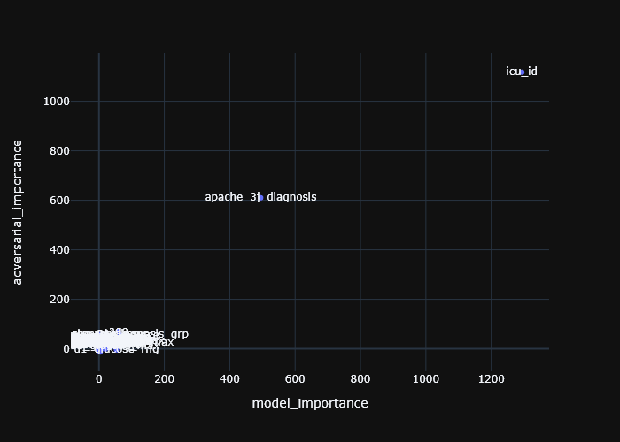
Important and Interesting Findings
Features on right have grater predictive power than features on left.
Upper features makes dataset biased (i.e., predictions less robust) than features in the bottom
ICU_ID and apache_3j_diagnosis are completely outstanding in both directions
Kaggle Winner Presentation Template
Notes:
This ‘Map’ presents each feature’s ‘model_importance’ vs. ‘adversarial_importance’
‘model_importance’ – calculated using model on slide #10 (Catboost, on Selected Features before Bias Mitigation, w/o Data Imputation, Train Set)
‘adversarial_importance’ – calculated using the same ‘light_gbm’ model used for adversarial validation
‘Bias Mitigation’ – will be done using the features outstanding in both directions (important for the model & in adversarial terms)
Medical meaning of outstanding features:
‘icu_id’ - A unique identifier for the unit to which the patient was admitted
‘apache_3j_diagnosis’ – The APACHE III-J sub-diagnosis code which best describes the reason for the ICU admission, indicating Severity of Illness
These 2 features are related in terms of medical logic: The unit to which the patient was admitted to (‘icu_id’) is related to the reason for icu admission (‘apache_3j_diagnosis’)

Slide 21
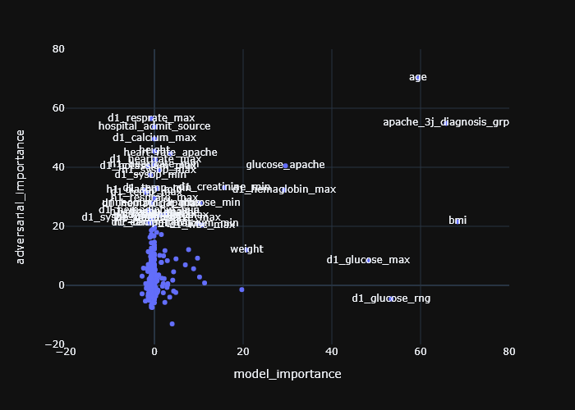
Important and Interesting Findings
Zoom in into majority of features
In theory, features with model_importance ~ 0 may be arguably removed (we did not do that)
Kaggle Winner Presentation Template
Notes:
‘Arguable Features’ - Features on Y-axis with ‘Zero-Model-Importance’ and high ‘Adversarial_Importance’ may ‘arguably be removed’ because:
‘Bias’ features contain information (even only by being ‘bias’)
Different models may produce different results in terms of ‘model_importance’ and ‘adversarial_importance’ of each feature (this is only the result of one model)
Our preference was to provide the model with as much information as possible, therefore we did not remove those ‘Arguable Features’ from our dataset

Slide 22
Important and Interesting Findings
To fix that, we encoded all biased features
For each feature we took all min-max-rng-avg-apache features, calculated mean and added as additional features
Totally ~200 new features for each biased feature
Other winning teams reported other elegant (more or less) solutions they used and managed to mitigate the bias
In practice, all teams who didn’t handled bias was decreased in their private leaderboard position.
Kaggle Winner Presentation Template
Notes:
Our bias mitigation was done as follows:
Diagnosis of ‘Outstanding Features’ to be Mitigated (using the maps above) ~ 6 features (icu_id, apache_3j_diagnosis etc.)
In order to DISSEMINATE the differences between the Train set and the Test set, Both Train Set and Test Set were combined to a Single Dataset
For each ‘Outstanding Feature’:
We took numerical features (min / max / rng / avg / apache) ~ overall 200 features
For each combination of the numerical features and the ‘Outstanding Features’ we produced a dedicated Feature – overall ~1200 additional Features (200*6)
This feature represents a calculated mean of the ‘numerical features’ values corresponding to each value of the ‘Outstanding Feature’ from both Train Set and Test Set
Example: In Feature ‘d1_diasp_max_icu_id’, for each value of ‘icu_id’ (e.g. ‘icu_id’=92), we calculated the mean of all corresponding ‘d1_diasp_max’ values (from train & test)
After producing all additional features, we removed the ‘Outstanding Features’
Validation of ‘Bias Mitigation’ – recalculating ‘adversarial_importance’ of each ‘Outstanding Feature’, and verifying it was decreased
Bias Mitigation was essential in this challenge
Teams who did not mitigate their bias decreased their leaderboard positions
Other winning teams also reported elegant (more or less) bias mitigation methods

Slide 23
Important and Interesting Findings
We was first to create many features (without publishing), which was later created by other participants. Like H1/D1 average and amplitude.
Difference of H1 and D1 measurements – it may point on treatment received (i.e., medicine pill to stabilize the blood pressure). We think if those features (H1 and D1 treatment) will be gathered and added to the data, they will impact a lot!
Kaggle Winner Presentation Template
Notes:
Overall we had 2,500 Features:
1,300 given / produced by us / produced by the community – not related to ‘bias mitigation’
1,200 produced by us during ‘bias mitigation’
Some of the features we created ourselves, and later saw were also created by other participants, e.g. H1/D1 Average and Amplitude
d1_average (example): (d1_diasbp_invasive_max + d1_diasbp_invasive_min)/2
d1_amplitude / range / diff (example): d1_diasbp_invasive_max - d1_diasbp_invasive_min
After ‘Feature Selection’ (using ‘light_gbm’) we remained with 1,000 Features
Differences between H1 and D1 measurements:
As mentioned, the ‘rng_diff’ feature we created contains much information regarding the dynamics of the patient’s metabolic state during the 1st 24 hours
It may be an indicator of ‘hidden’ information regarding treatments received, changing the glucose level throughout the day (d1)
Therefore we presume that providing the following additional information would have made a great impact:
Additional measurements representing the dynamics throughout the 1st day – glucose level, blood gas, pH etc.
Treatments received throughout the 1st day

Slide 24
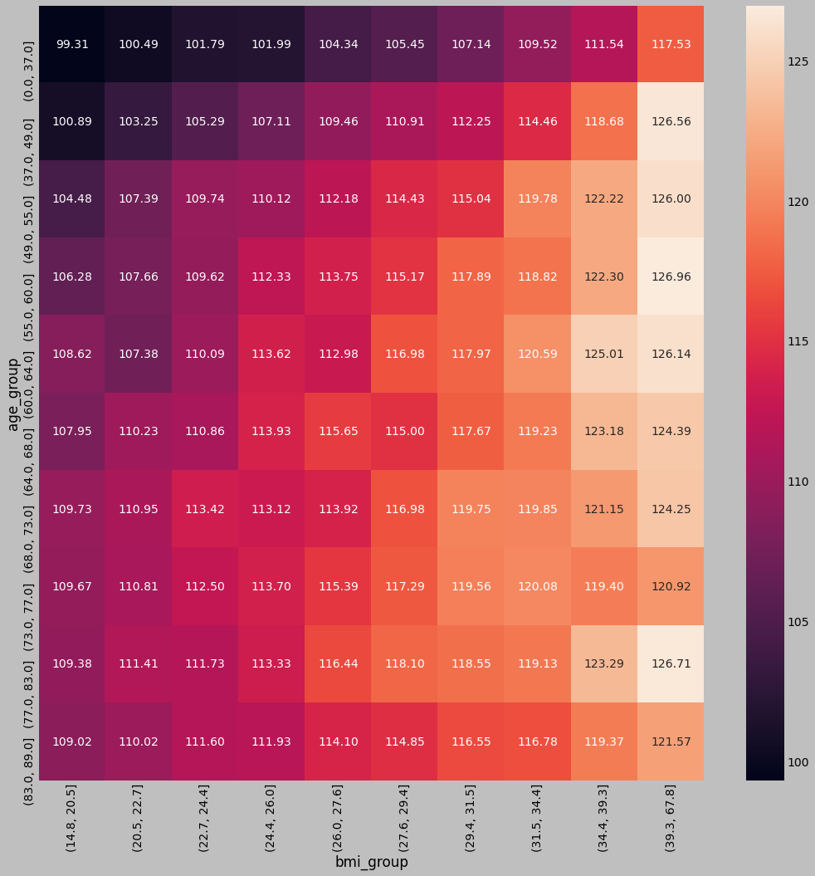
Important and Interesting Findings
Cluster-based missing values imputation – some vitals have a normal range changed based on age or other parameters.
Example plot: BMI and age divided into deciles
Values vary from 99.31 to 126.96
Total mean is 114.44
Using total mean will completely disturb the data
Kaggle Winner Presentation Template
Notes:
Another challenge we faced was completing missing data
There are some features whose ‘Healthy Level’ values depend on other parameters, e.g the ‘Healthy Levels’ of ‘Glucose’ are dependent on ‘Age’ and ‘BMI’
For these features we implemented Cluster-Based Missing Values Imputation using Kmeans, as demonstrated in this slide
‘Cluster-Based’ clusters the values according to clusters of parameters on which they depend, and imputes the values according to their cluster
This plot presents the ‘d1_glucose_min’ feature divided into BMI & Age deciles. In each cell of this matrix is the corresponding ‘d1_glucose_min’ mean
It can be seen that ‘d1_glucose_min’ values are highly correlated to BMI & Age, and its ‘Healthy Level’ changes according to the decile
100 values (in each decile) ranging from 99.31-126.96 Vs.
Total Mean of 114.44
In terms of ‘Health Levels’ for each group (cluster) – this makes a great difference
Imputing all missing values with the ‘Total Mean’ may distort the data in the following sense:
Populations whose ‘Healthy Level’ is different than ‘Total Mean’ may unjustifiably appear to more commonly have ‘Unhealthy Levels’
This may be especially disturbing in case the values were missing because they were redundant (other indications implied they were proper)
It may even be more disturbing as ‘d1_glucose_min’ is a highly important feature (see slide #10) with a great predictive power
Although some models in certain cases may perform better without data imputation (e.g GBM Catboost), some other models (e.g. tabnet) may need complete data in order to produce optimized results
Distorted data produces distorted predictions, even when using the best most optimized models
Therefore proper data imputation (adapted to each case) is necessary to obtain optimized results, especially when following the NFL theory and using a span of highly diverse models

Slide 25
Simple Model

Slide 26
Simple Model
 | CV | Public LB | Private LB
Ensemble Model | 0.88131 | 0.87365 | 0.87669
Best Single Model | 0.87822 | 0.87140 | 0.87226
We reran the full solution with seed and private score was dropped from 0.87997 to 0.87669, which is still 3rd place score.
The difference between ensemble and best single model is small, that is what differentiate between good solution for production and prize-winning solution which is very hard to put into production.
Best single model is a CatBoost classifier trained on full dataset before feature imputation
Notes:
In this slide we can see our models & scores
This slide shows our results – CV (private computer), Public LB, Private LB
When rerunning the full solution after winning 3rd place, it was dropped from 0.87997 to 0.87669 (0.003) – which is still 3rd place (4th place is 0.87658)
‘Ensemble’ vs ‘Best Single Model’
Difference in scores between ‘Ensemble’ and ‘Best Single Model’ may seem minor on one hand (0.00443), but is critical to a prize-winning solution on the other hand
If the goal was a solution for production, the ‘Best Single Model’ would have been more appropriate (differences in score are insignificant, much easier to put into production)
The best single model is a ‘Catboost’, providing optimized results when trained on data before feature imputation

Slide 27
Question and Answer

Slide 28


